Slide 1
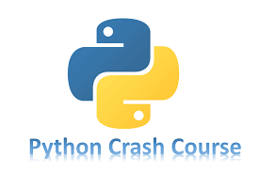

Slide 2
Chapter 11
TESTING YOUR CODE
Brief Summary of Chapter 11
In Chapter 11, we'll cover how to test functions and classes using pytest. We'll start by writing tests for simple functions, ensuring their outputs are correct. Then, we’ll move on to testing classes, like the AnonymousSurvey class, to verify that methods work as expected. Lastly, we'll introduce pytest fixtures, which help make testing more efficient by reducing repetitive code and reusing resources across multiple tests.

Slide 3
Installing pytest with pip
Pytest is a third-party Python library used for writing and running tests to check if your code behaves as expected, helping developers identify issues. Pip is a package management tool that comes with Python, allowing users to install, upgrade, and manage external libraries like pytest. By running the command python -m pip install, users can easily add new functionality to their projects, including installing packages specifically for the current user with the --user flag.
NB!!! If you’re using Linux, pip may not be included with your installation of Python. If you get an error when trying to upgrade pip, see the instructions in Appendix A. on Page 463.

Slide 4
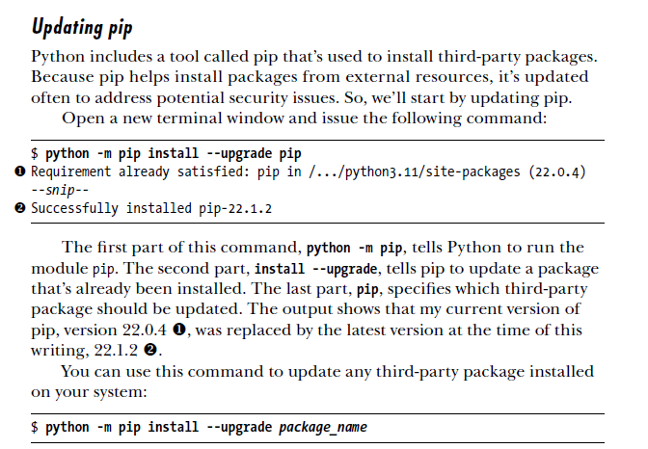

Slide 5
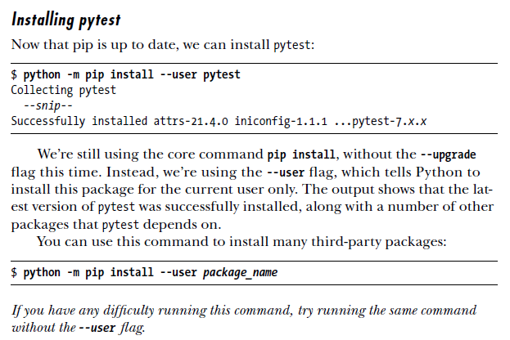

Slide 6
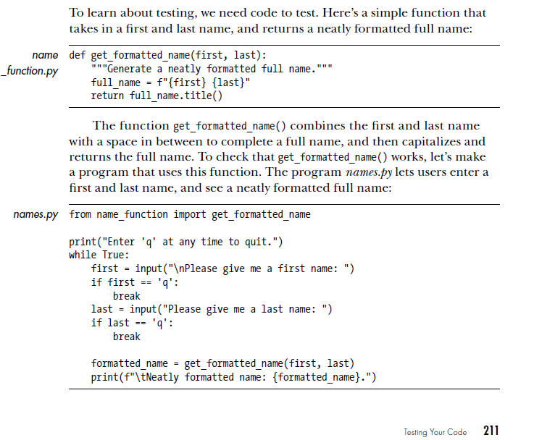
Testing a Function

Slide 7
Unit Tests and Test Cases
There are many approaches to testing software, with one of the simplest being a unit test. A unit test checks that a specific aspect of a function's behavior is correct. A test case is a collection of unit tests that together ensure a function behaves as expected in all relevant situations. A well-designed test case considers all possible inputs a function might receive, with tests representing each scenario. Full coverage involves tests that account for all ways a function can be used, but achieving this on a large project can be overwhelming.
A Passing Test
With pytest, writing your first unit test is straightforward. We’ll write a test function that calls the function being tested and checks the returned value. If the check is correct, the test passes; if it's incorrect, the test fails.

Slide 8
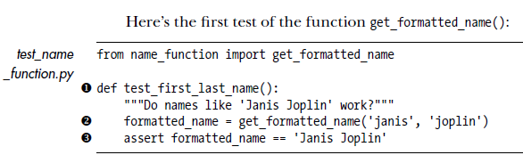
Importing the Function: The code starts by importing the get_formatted_name function from the name_function module.
Defining the Test Function: The test function test_first_last_name() is defined to test whether the function get_formatted_name() works correctly for names like 'Janis Joplin'.
Calling the Function: Inside the test function, get_formatted_name('janis', 'joplin') is called, and the result is stored in the variable formatted_name.
Assertion: The assert statement checks if formatted_name equals 'Janis Joplin'. If the values match, the test passes; if not, it fails.

Slide 9
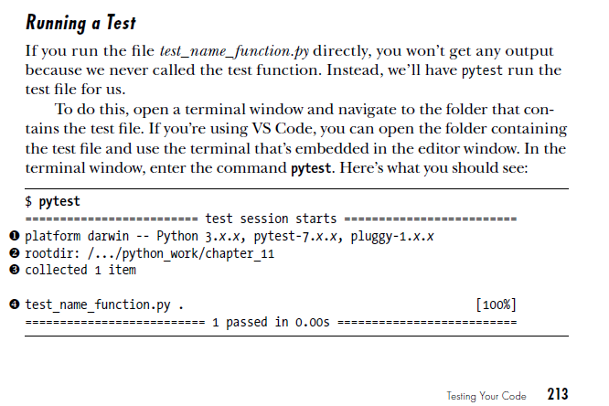
step 1: shows the platform, the Python version, the pytest version, and the pluggy version (a dependency of pytest).
step 2: is the directory where pytest is running the tests from.
step 3: tells you that pytest has found 1 test to run.
step 4: means the test file test_name_function.py ran, and the dot (.) indicates that the test passed. If there were any failures, you’d see an F instead of the dot.
1 passed in 0.00s:
This confirms that all tests passed (1 test in total), and it took no time at all to run.

Slide 10
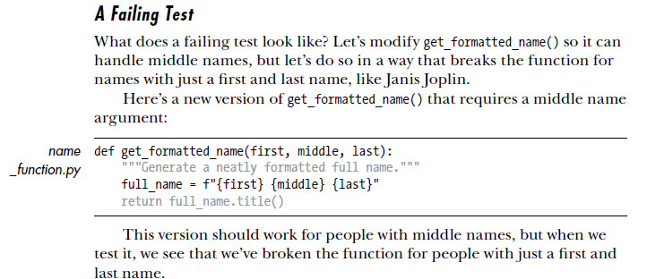

Slide 11
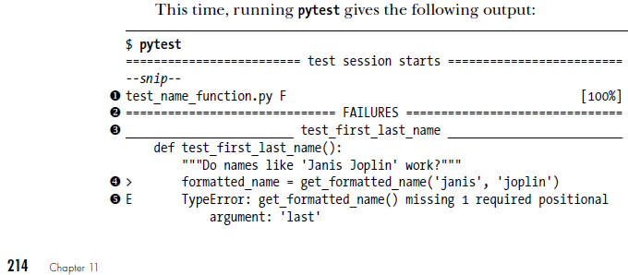
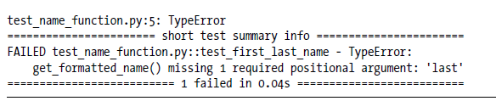

Slide 12
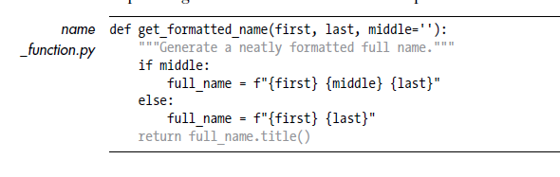
Responding to a Failed Test
When a test fails, don’t change the test itself; instead, fix the code causing the failure. A passing test means the function is working correctly, while a failing test indicates an error in your code. For example, if you added a middle name parameter to get_formatted_name() and it caused a failure, the best solution is to make the middle name optional by setting a default value. This allows the test for names like "Janis Joplin" to pass again while still handling middle names when provided. After making this change, rerun the test to ensure it works as expected.

Slide 13
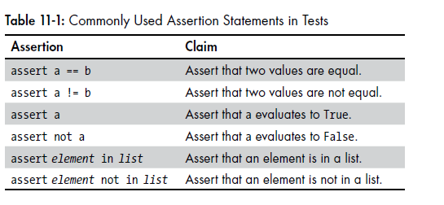
Testing a Class

Slide 14
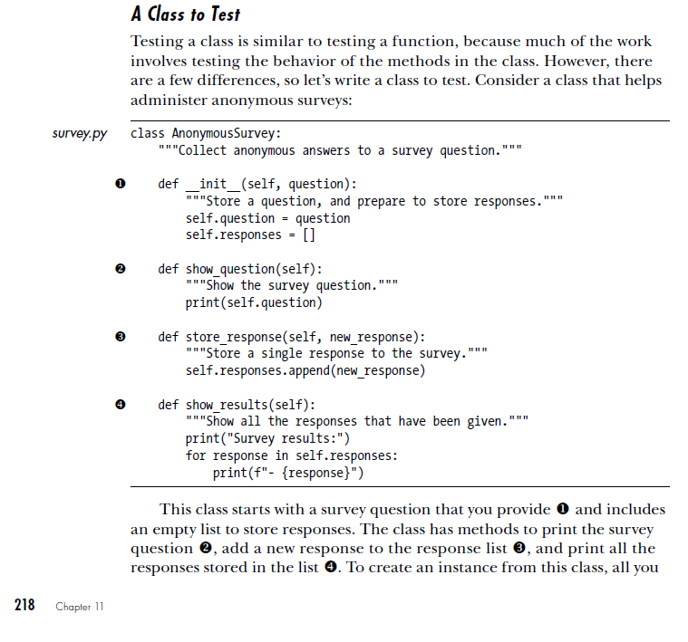

Slide 15
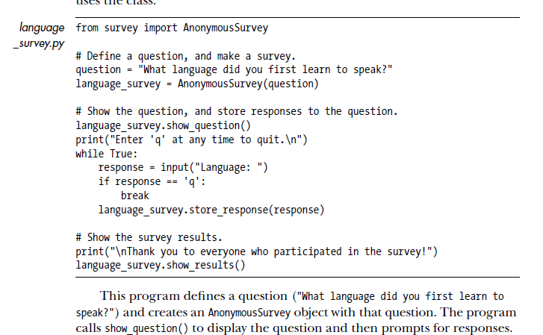

Slide 16
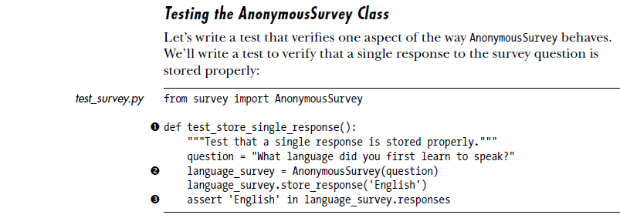
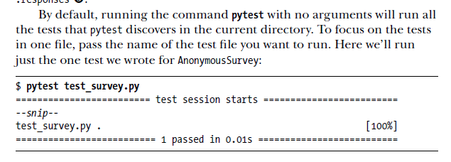

Slide 17
Using Fixtures
Fixtures in pytest set up test environments by creating resources shared across multiple tests. Instead of creating instances (like AnonymousSurvey) in each test, a fixture allows you to create and reuse them efficiently. You define a fixture with a function decorated by @pytest.fixture, which tells pytest to call it before running the tests

Slide 18
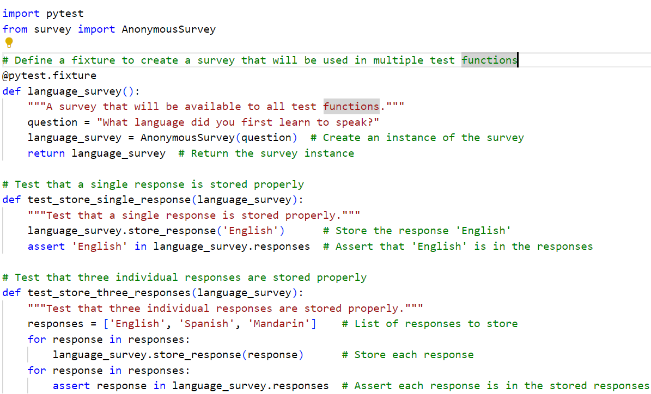

Slide 19
Practice Exercises
Do the following TRY IT YOURSELF on pages:
217
223

Slide 20
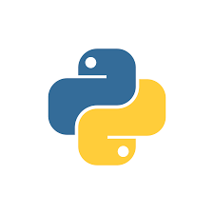
End
Of
Chapter 11

